Slide 1
Molecule
by CheckMate

Slide 2
Outline
Introduction to the team
Mind Map
Problem Statement
Proposed Solution
Data Sources
User Research
Methodology
Use Cases
Smart Solution
Impacts
References

Slide 3
Team Introduction
Azan Bin Zahid Full-stack Engineer, Arbisoft
Dilkasha Tarannum Data Scientist, Afiniti
Taimoor Ali Software Engineer, Conrad Labs

Slide 4
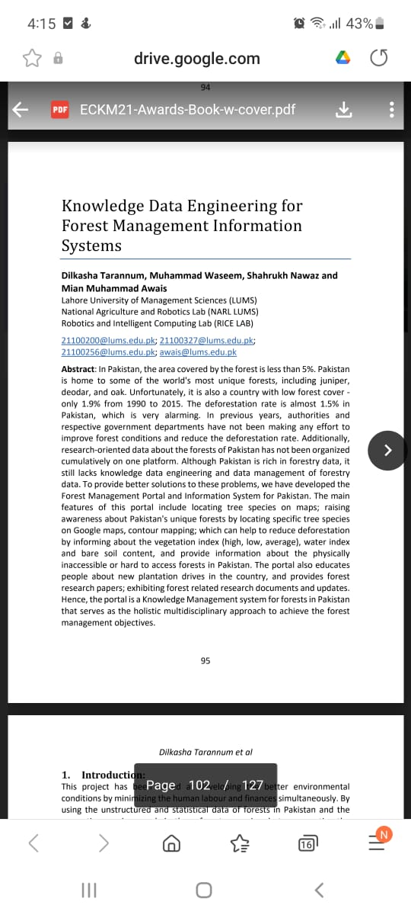
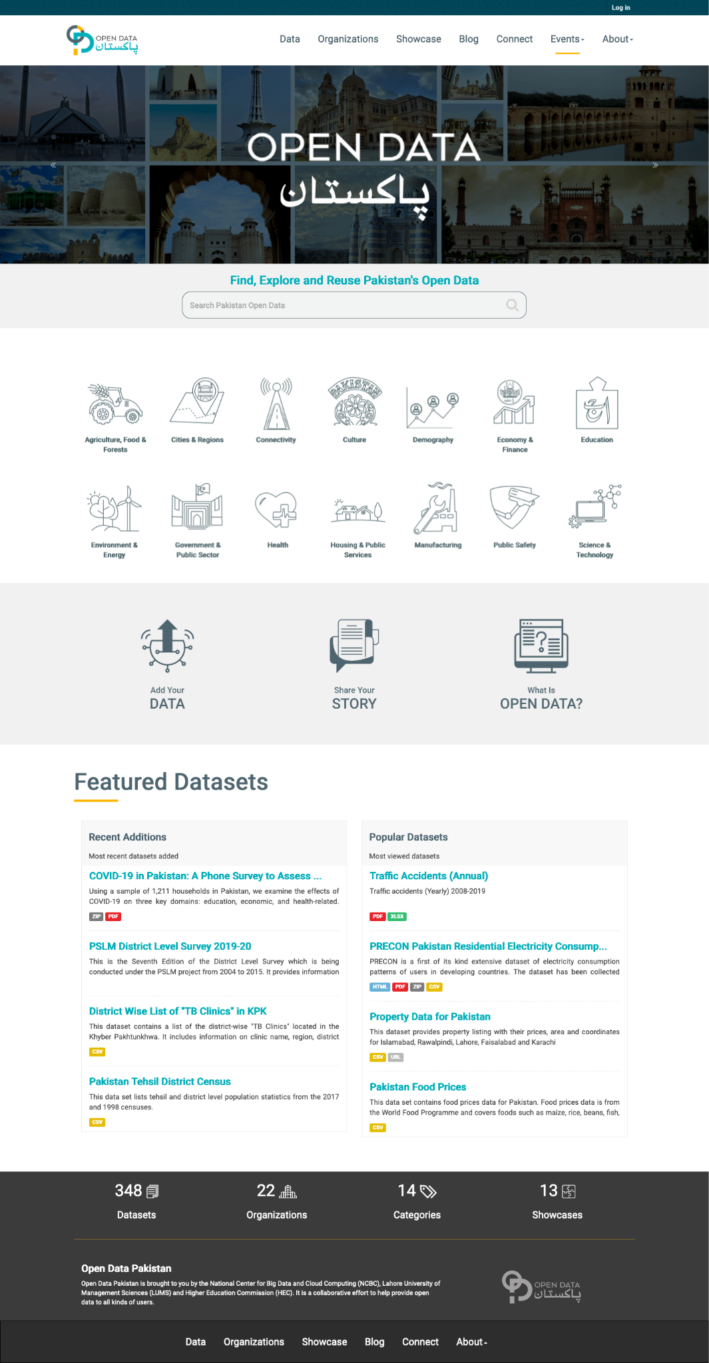
Background

Slide 5
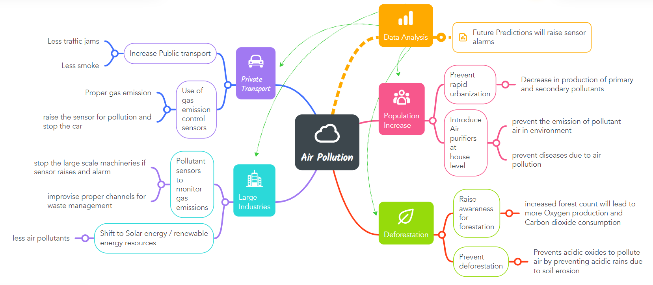
MindMap

Slide 6
Problem Statement
What are the key factors that contribute to air quality indices of specific regions and how can we help policy makers and individuals to visualize and extrapolate the impact of those factors to the Air Quality?

Slide 7
Problem Solution
We are unifying data from multiple nodes, modelling it in the form of graphical representations which will lead to the high AQI indicators and their correlation with various factors at a particular geospatial location. This will provide the viable environmental friendly, economical and smart solutions that could be implemented area wise.

Slide 8
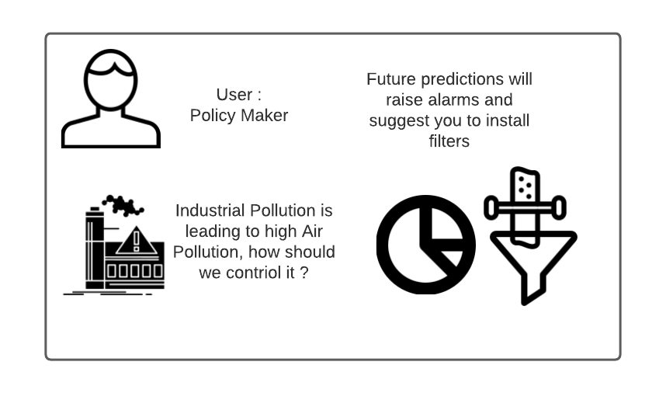
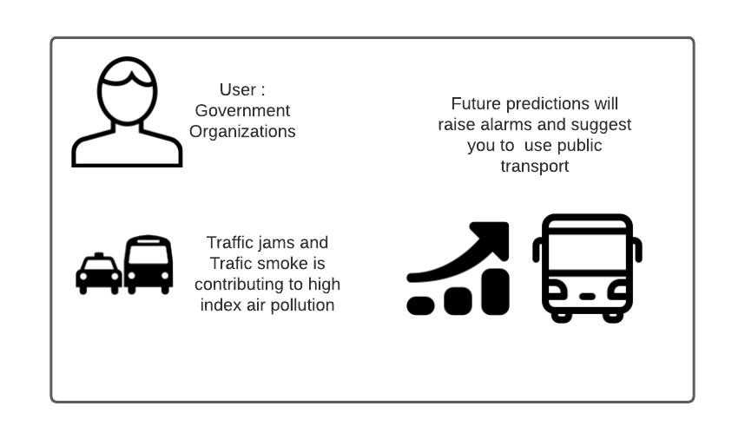
Use Cases

Slide 9
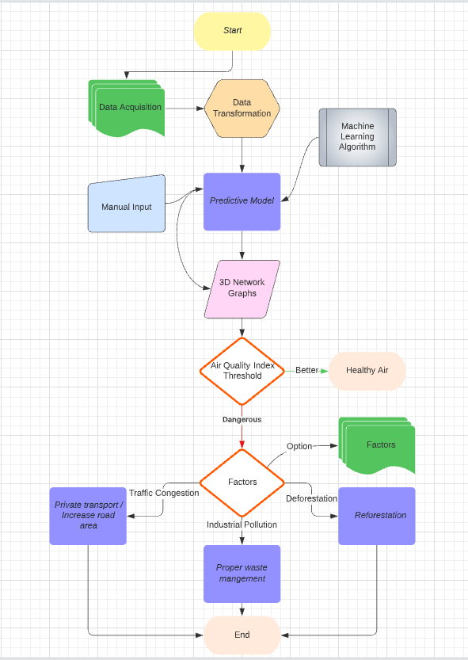
Methodology
Data Engineering
Machine Learning
Big Data Analysis
Software Engineering
Product Design
Human Computer Interaction

Slide 10
Weighted Network Graphs (MVP)
Runtime 3D analysis of Air Quality Index
Weighted effects of contributing factors
Manual Input for Correlative Analysis
Responsive Time Series Analysis

Slide 11
3D Network Graphs
Runtime 3D analysis of Air Quality Index
Weighted effects of contributing factors
Manual Input for Correlative Analysis
Responsive Time Series Analysis

Slide 12
Smart Solutions
Artificial Intelligent sensors to monitor Forest Cover at real time
Intelligent sensors to monitor Traffic Lights timing
Smoke filters in private vehicles
Smart Sensors to monitor the emission of Greenhouse Gases
Reforestation and restricted deforestation
Air purifiers used at individual level
Increased Public transport and Carsharing
Proper waste management at Industries
Improve the roads infrastructure
Remote forest health monitoring

Slide 13
Data Sources
Traffic Congestion: Google maps Traffic data
Deforestation: Satellite Images and NDVI maps
Population: National Population Census
Industrialization: National Population Census and online resources

Slide 14
User Research and Assumptions
Our users primarily consist of the Policy makers, Government organizations and other related industries.
Due to time constraint we could not gather runtime data so we have our analysis based on limited data. However, the predictive models have been trained using the retrospective available data.

Slide 16
Future Impacts
Predict the future threats
Suggest precautionary measures
Interactive Factor wise analysis
Scalable and Adaptable Product

Slide 17
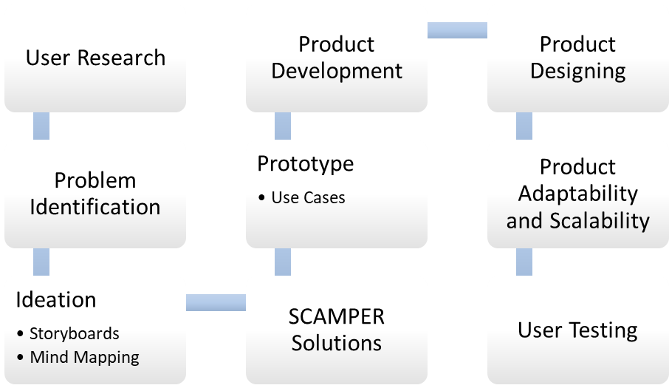
Product Development Life Cycle

Slide 18
References
Minallah, Muhammad. (2020). Exploring the Relationship Between Land Surface Temperature and Land Use Change in Lahore Using Landsat Data. Pakistan Journal of Scientific and Industrial Research Series A: Physical Sciences. 63A. 188-200. 10.52763/PJSIR.PHYS.SCI.63.3.2020.188.200.
Munawar, Saima & Hamid, Dr & Khan, Muhammad & Ahmed, Ashfaq & Hameed, Noreen. (2017). Health Monitoring Considering Air Quality Index Prediction Using Neuro Fuzzy Inference Model: A Case Study of Lahore, Pakistan. Journal of Basic & Applied Sciences. 12. 10.6000/1927-5129.2017.13.21.
Toma, Cristian et al. “IoT Solution for Smart Cities' Pollution Monitoring and the Security Challenges.” Sensors (Basel, Switzerland) vol. 19,15 3401. 2 Aug. 2019, doi:10.3390/s19153401

Slide 19
Thank you
CreditBook
Devnation
Colabs

